Slide 1
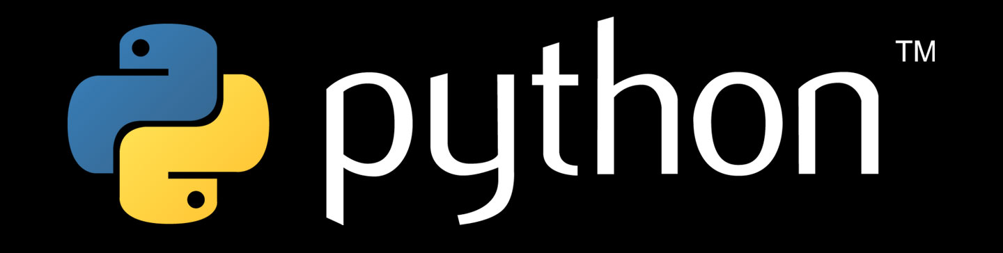
Functions

Slide 2
This CLASs
Outline:
Introduction – What, Why, Who, Where, When, How
Basics – python files, syntax, assignment, imports
Data types –numbers, strings, lists, and dictionaries
Flow control – conditions and logic
Functions – reusable code
Program development
Course content, code samples, and tools
Notebook Viewer

Slide 3
Anatomy of a function
def function_name(parameter1, parameter2, etc):
‘‘‘docstring’’’
function body…
return
def keyword that defines the function
docstring Description of the function
function_name name of the function
parameters the argument(s) supplied to function
: closes the function definition
function body what the function does
return what the function returns to the caller

Slide 4
Anatomy of a function
def function_name(parameter1, parameter2, etc):
function body…
return
function_name(param1, param2)

Slide 5
Anatomy of a function
def function_name(parameter1, parameter2, etc):
function body…
some_value = ‘Spam and Eggs!’
return some_value
new_value = function_name(param1, param2)

Slide 6
Anatomy of a function
Parameters can be passed by index or by keyword:
def my_function(x, y):
return x ** y
Index:
new_value = my_function(5, 3)
Keyword:
new_value = my_function(x=5, y=3)

Slide 7
Anatomy of a function
Parameters can also be optional and have default values:
def my_function(x=1, y=2, z=3):
return x * y * z
new_value = my_function(5, 3, 1)
new_value = my_function(x=5, y=3)
new_value = my_function(x=5, z=5)
new_value = my_function(5, z=9)

